Slide 1
Welcome To Vehicle Management Project
Developer Team - C

Slide 2
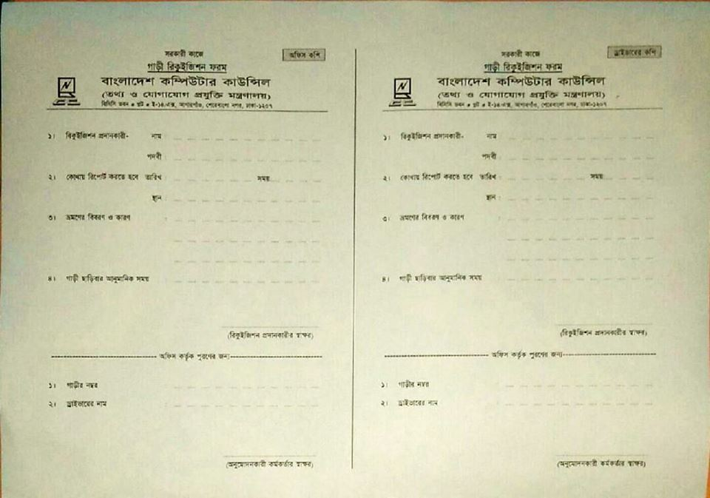

Slide 3
User Stories
Back Log for user
As a user I want to login. So that create login form.
As a user I want to search vehicle. So that create search option.
As a user I want to send a requisition for vehicle. So that create requisition form.
As a user I want to cancel requisition. So that create cancel button.
As a user I want to select vehicle and driver. So that create a option for select.
As a user I want to get a conformation message in mail or mobile. So that create a info option.
As a user I want to print requisition copy . So that create a print option.

Slide 4
User Stories
Back Log for Controller
As a admin I want to get user list. So that create a user list.
As a admin I want to create vehicle list. So that create a option for vehicle entry.
As a admin I want to create a driver list. So that create a option for driver entry.
As a admin I want to requisition search option. So that create a requisition list.
As a admin I want to approve requisition . So that create a requisition approve field in list.

Slide 5
User Stories
Back Log for Controller
As a admin I want to send conformation mail or message to user. So that create conformation info.
As a admin I want to deactivate vehicle and driver. So that create a option in vehicle and driver list.
As a admin I want to create check-in or check-out . So that create a option.
As a admin I want to reassign requisition. So that create a option.

Slide 6
VehicleType Entry Form (Controller)
Object: VehicleType
Attribute
Id;
TypeName;
Description;
Activity:
CreateType();
TypeList();
Title | Text Box
TypeName*
Description

Slide 7
Vehicle Entry Form (Controller)
Object: VehicleEntry
Attribute
Id;
VehicleTypeId;
RegNo;
Description;
DriverId;
IsDelete;
Activity:
CreateVehicle();
VehicleList();
Title | Text Box
VehicleType*
Registration No*
Driver
Description

Slide 8
Driver Entry Form (Controller)
Object: DriverEntry
Attribute
Id;
Name;
LicenseNo;
MobileNo;
NID;
Address;
VehicleId;
IsDelete;
Activity:
CreateDriver();
DriverList();
Title | Text Box
Name
Mobile No
License No
NID
VehicleName
Address

Slide 9
User Designation Form (Controller)
Object: UserDesisgnation
Attribute
Id;
Designation;
Activity:
CreateDesignation();
DesignationList();
Title | Text Box
Designation
Description

Slide 10
User Registration Form (Controller)
Object: UserInfo
Attribute
Id;
Name;
DesignationId;
Email;
ContactNo;
Address;
Activity:
CreateUser();
UserList();
Title | Text Box
Name
Designation
Email
Mobile No
Office Address

Slide 11
Action Form (Controller)
Object: RequisitionInfo
Attribute
Id;
UserInfo;
RequisitionInfo;
VehicleInfo;
DriverInfo;
CancelRequisition;
ReassainRequisition;
Activity:
RequisitionList();
SearchRequisition();
ApproveRequisition();
CancelRequisition();
CheckInTime();
CheckOutTime();

Slide 12
Requisition Form (User)
Object: Requisition
Attribute
Id;
RequisitorName;
Designation;
Email;
ContactNo;
JourneyDateTime;
Place;
Description;
JourneyStartTiem;
VehicleName;
DriverName;
Activity:
CreateRequisition();
SearchVehicle();
RequisitionList();
CancelRequisition();
Title | Text Box
Requisitor Name
Designation
Email
Mobile No
Journey DateTime
Place
Journey Description
Journey Start Time
Vehicle Name
Driver Name

Slide 13
User Diagram
Login
Search Box:
Home | My Profile | Requisition | Vehicle Search |  | My Request | Feedback | Logout

Slide 14
Controller Diagram
Login
Search Box:
Home | Vehicle | Driver | User | Action | Logout
Vehicle Type |  | Add Vehicle |  | Vehicle List
Add Driver |  |  | Driver List
Add Designation |  | Add User |  | User List
Action Details

Slide 15
Thanks To All

